Slide 1

Analytics & Insights
Feature Analysis
Service
December 2025

Slide 2
FEATURE OVERVIEW
December 2025 Update
The Service feature analysis, presented in March 2025, has been updated in this deck to reflect 2025 data.
Original presentation is linked here: Start Services - A&I Feature Analysis (March 2025).pptx

Slide 3
01
Data Analysis

Slide 4
DATA ANALYSIS
Executive Summary: 2025 updates
Service Transaction completed via Digital channels VS CSR
Completion Rate through Web
Residential vs. Non-Residential
Errors - 180 days
87k 89%
2023
2024
2025
2023
2024
2025
CSR
52%
59%
55%
Residential
53%
52%
59%
Start Services Eligibility Errors
48%
41%
45%
18%
3%
2%
8k 8%
Digital
Non-Residential
Start Service Errors
Completion Rate (Web Only)
2023
2024
2025
51%
61%
57%

Slide 5
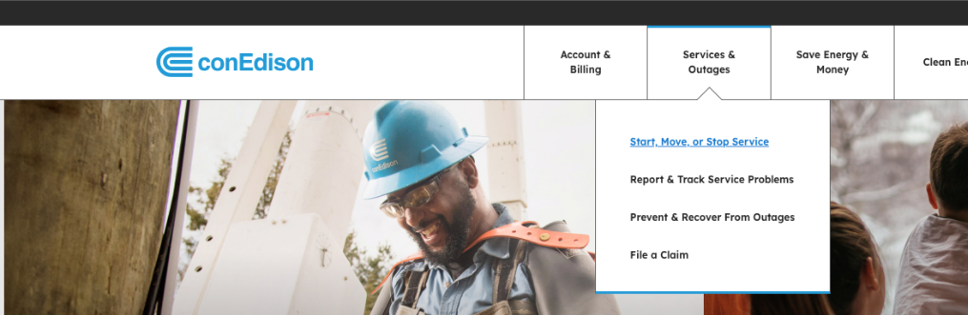
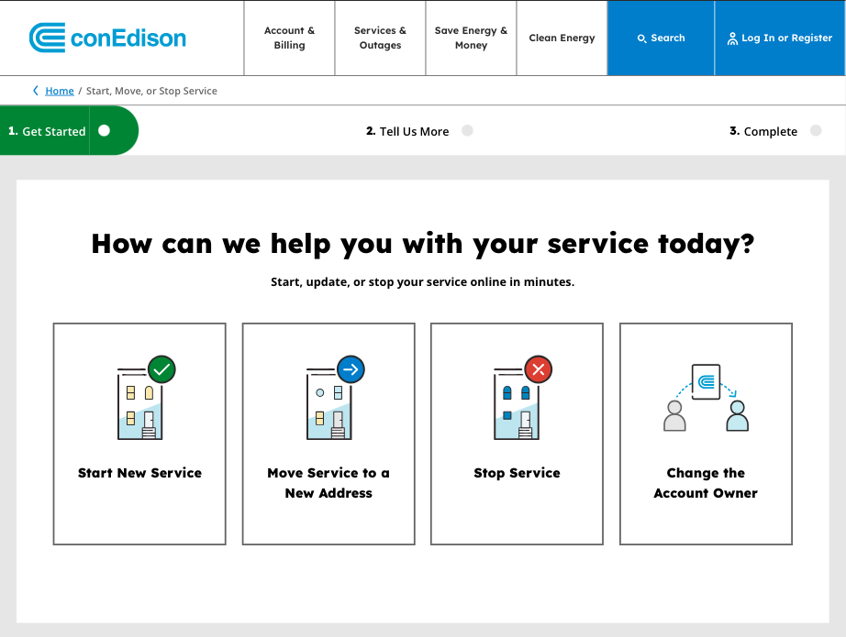
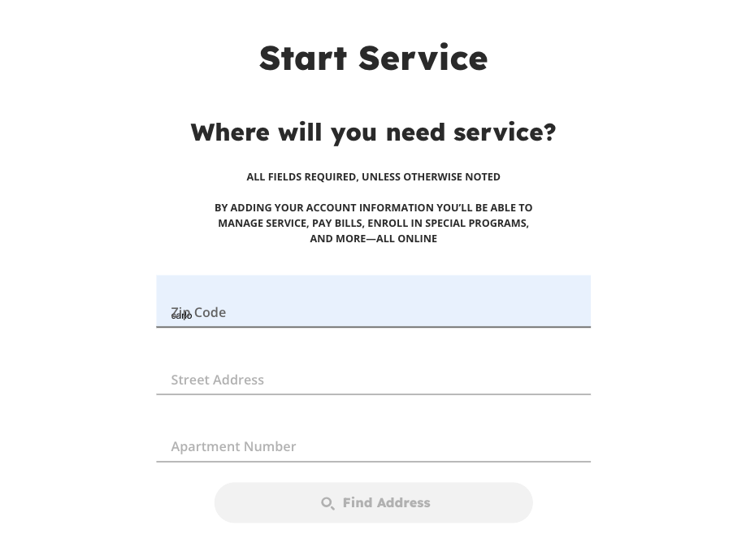
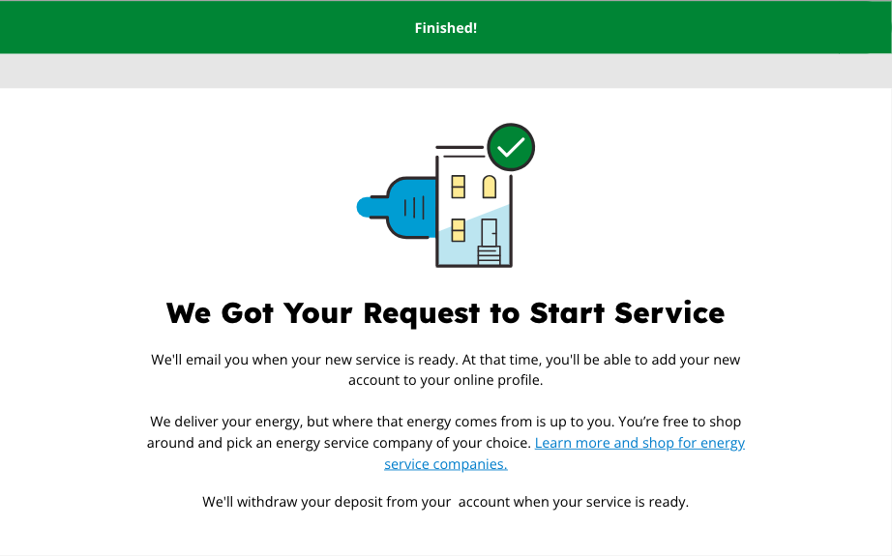
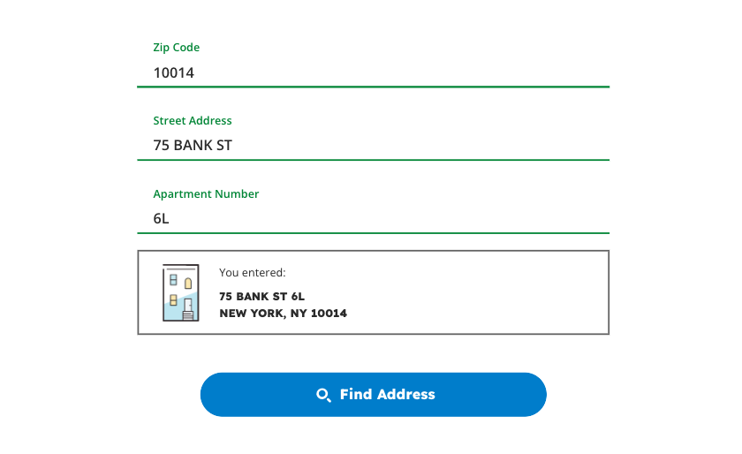
DATA AND EXPERIENCE ANALYSIS
We see a significant drop-off in the flow at the address look up phase – where eligibility errors occur.
Homepage Global Nav
Start Service Flow
65% Completed address look up
70% Start Service Submits
107k users
361k users
232k users
175k users
(01/01/2025–12/21/2025)

Slide 6
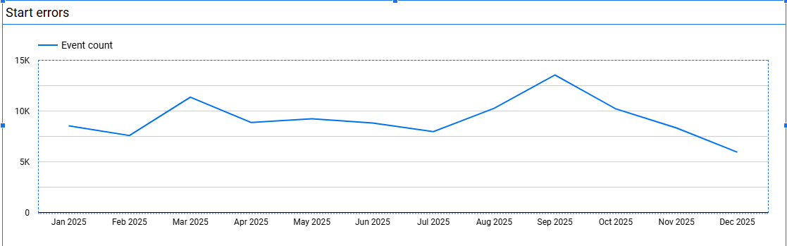
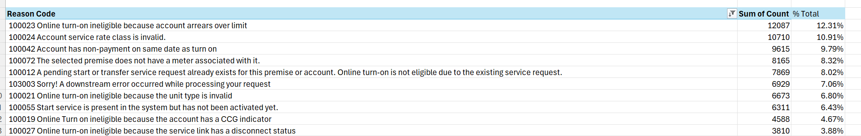
DATA ANALYSIS
Majority of errors preventing customers from completing the flow are eligibility related.
89k 95%
8K 8%
Eligibility-related Errors last 180 Days
General Start Service Errors – input field validation
Start Services Top Error Codes Details Site Core
last 180 Days (07/22/2024–01/21/2025)
Notes:
Credit limits will increase soon for start service as arrears over limit is around 18% of total errors. There were bugs with addres look up as we see the erros going up from May to October 2024.

Slide 7
DATA ANALYSIS
Services 2025 Arrears
The missed opportunity for DCX lies in new customers (111K residential, 89K non-residential) with zero arrears who rely heavily on CSR channels.
3200K
200K
Service through CSR
Accounts with arrears =<0
count(Acct_id) | ACCOUNT_AGE
192,582 | 0 to 1 years
1,691 | 1 to 3 years
1,077 | 10 plus years
551 | 3 to 5 years
595 | 5 to 10 years
89K
2.5K
111K
Non_res accounts with >0 arrears
>0 arrears non-res
0 arrears non-res
39K
1.8K
89K
Residential accounts with arrears >0
>0 arrears residential
0 arrears residential
Notes:
Account with 0 arrears are opportunity for dcx that are missed. Majority of new customer who are 0-3 years seems to rely more on CSR channel. Missed opportunity is new customers 99k +78K with no arrears on the account. How do we get to them? 85k for residential and 27k for Non res, >3k. 2k over 3k and 7k over 3 for non-res

Slide 8
DATA ANALYSIS
Explore downstream error - resulting in API call failure.
Insight:
Top account issues preventing digital transactions:
Service turned off for non-payment, ~12% of errors
API call failure (downstream error), ~7% of errors
Ineligible rate class for online service start, ~11% of errors
  The selected premise does not have a meter associated with it, ~8% of errors ( this was from a CCB issue that lasted over a month)
Recommendation:
Set up monitoring in Azure Application Insights to track exceptions and error trends. Configure thresholds so that when specific error codes increase beyond normal levels, the team is automatically notified. This allows quick investigation and timely corrective action.
Notes:
As a customer with 2 to 6 service accounts, I find the Account Focus feature frustrating because it directs me to a single bill payment view. I wish I could access the Pay Multiple Bills page directly, like customers with 7 or more accounts, to manage my payments more easily.

